Slide 1
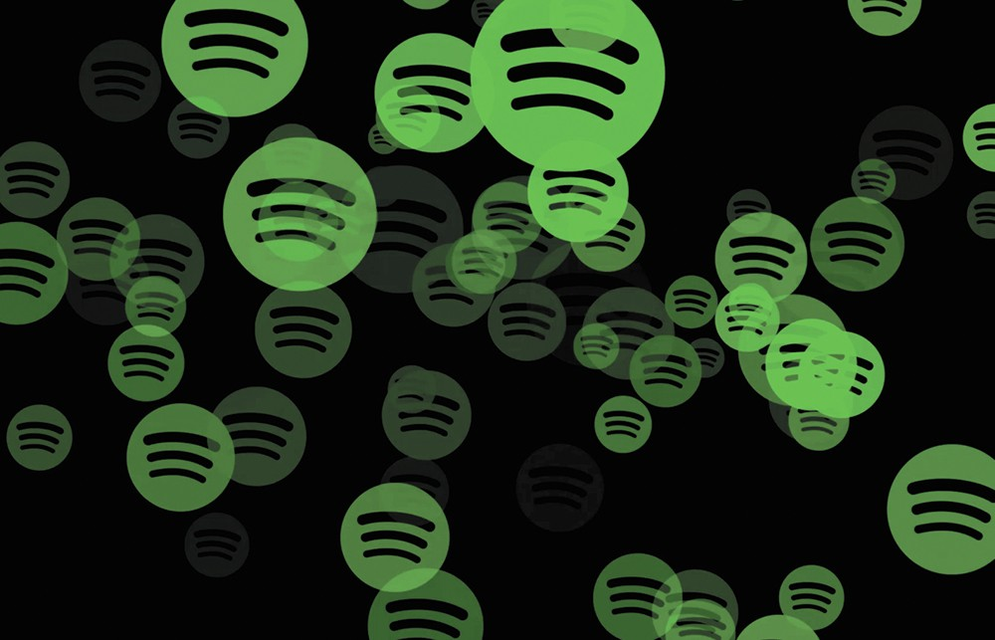
Spotify Track Recommendations
Improve shuffling with Unsupervised Learning as your DJ!

Slide 2
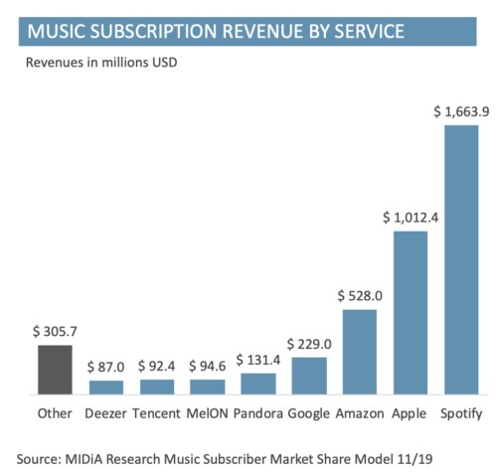
Background
As an industry leader, Spotify must prioritize customer experience in order to avoid losing paid subscription members to competitors
Retention is critical especially given the thin margins of this space with royalties due to the artists and the record labels.
How can we improve user experience? How do we keep the user engaged and listening?

Slide 3



Who might care?
Spotify
Spotify Paid Users
All Global Listeners (free version!)

Slide 4
Track + Audio Features
Tracks
Artist(s)
Popularity
Genres
Duration
Track Name
Date Saved
Audio Features
Danceability
Energy
Key
Mode
Loudness
Speechiness
Acousticness
Instrumentalness
Liveness
Valence

Slide 5
Data Summary
Saved tracks from between 09/2014 through 08/2020, collected through Spotify API via the Spotipy python library
665 tracks saved
27 total columns used
Track and audio features merged via track_id

Slide 6
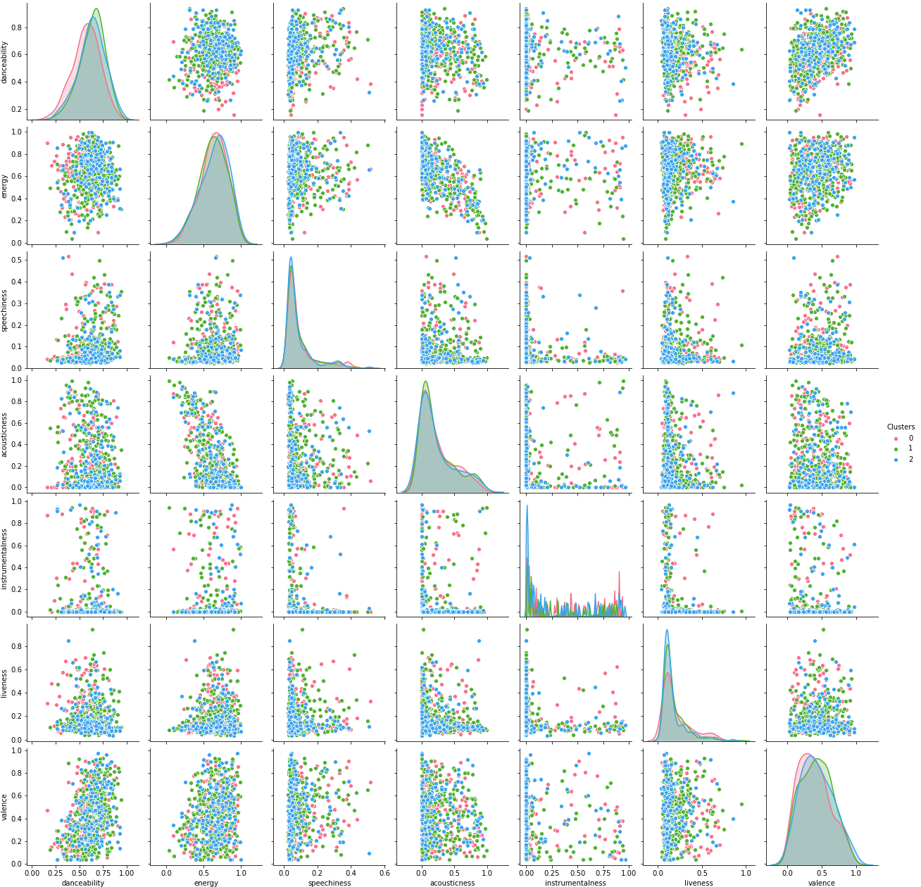
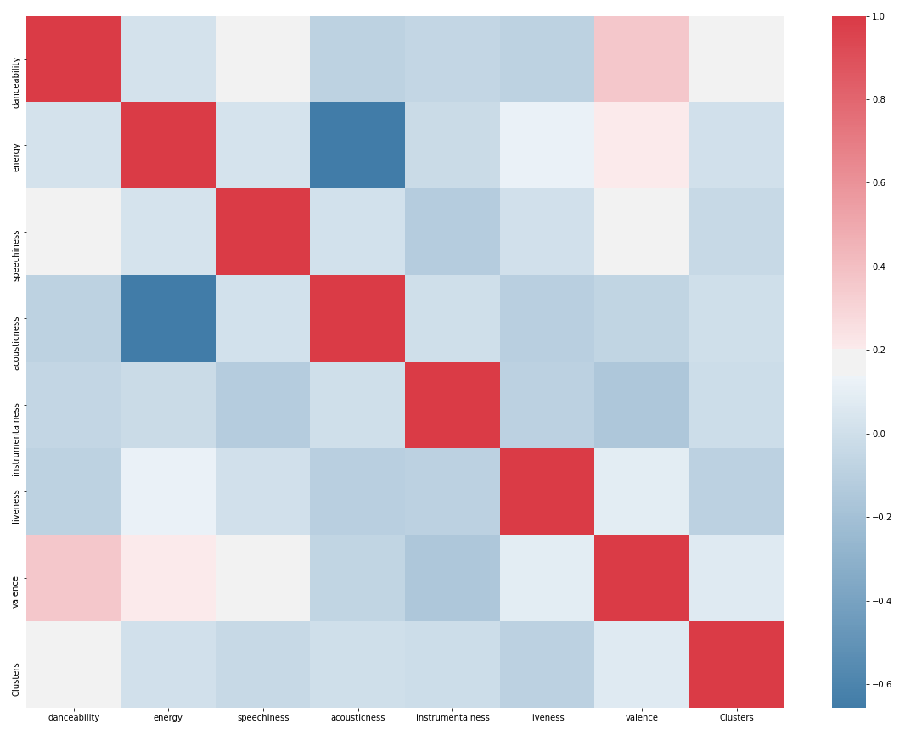
General Data Exploration

Slide 7
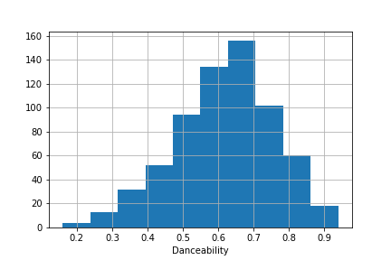
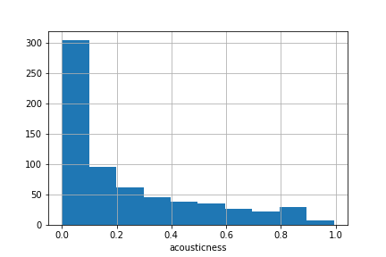
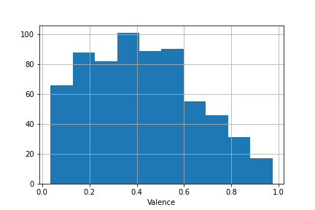
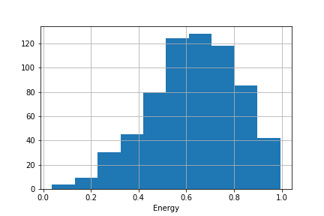
Audio Data Exploration
Audio Features scaled from 0-1

Slide 8
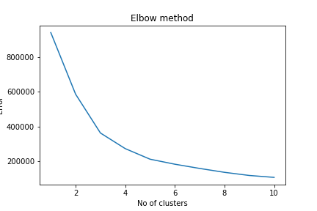
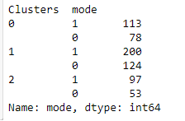
Cluster Analysis
After breaking library into three clusters via K-Means and elbow plot heuristic, we can see a clearer picture of classes of tracks
Spotify API codes mode 1 as major key (happy) and 0 as minor key (sad). From the clustering, we can see that each cluster is generally major with cluster 0 being the least minor.

Slide 9
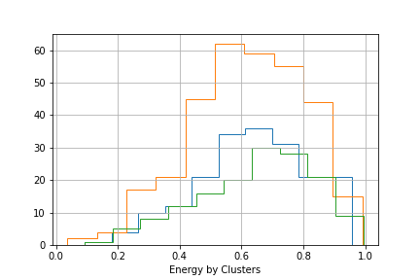
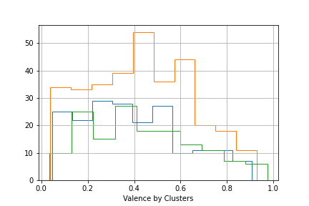
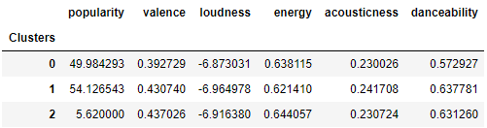
Cluster Analysis cont
Clusters suggest two ‘happy’ high-energy clusters with one tending to be more popular and one ‘sadder’ clusters that is slower and less upbeat.

Slide 10
Modeling - Summary
Unsupervised learning - Choosing next track based on how closely it relates to the current one
Scaling required as some columns have larger ranges than others
Recommendations - Attempted TF-IDF but eventually settled on K-Means with size of recommendation playlist = number of neighbors
Tools: Python - Scikit-Learn NearestNeighbors and preprocessing modules

Slide 11
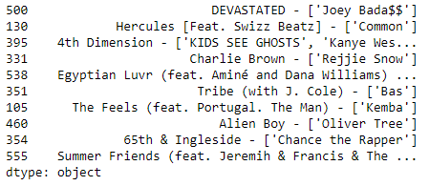
Modeling - Simple, genre-based
Spotify associates genres to artist level very generously (not unusual for 5+ genres for an artist)
Simple model for measuring similarity applied here to artist genres can be effective in producing related artists
However this model is weak for tracks since similar artists will produce similar recommendations as they would have the same genres
Example to the right seeded with rap artist, the tracks are fairly different in sound despite all artists being rappers

Slide 12
Modeling - Track Features recommendations
KNN to neighbor similar tracks based on euclidean distance between each track’s audio features so track features are fully factored into recommendation decision-making
Some artist dataframe columns included as part of the final frame for model fitting
Artist Features
Track Features
Final DataFrame

Slide 13
Modeling - Tuning
Different scaling methods used as these influenced recommendations
MinMax Scaling
Standard Scaling
Absolute Max Scaling
Clustering into 3 groups generated previous in the EDA step also leveraged as a column

Slide 14
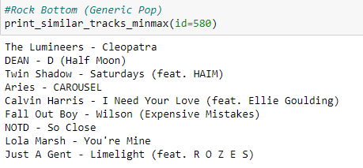
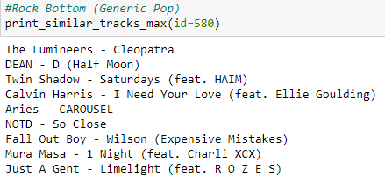
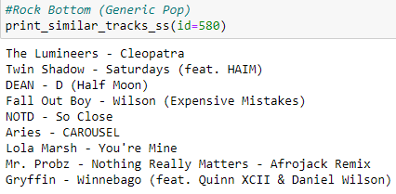
Scaling shapes recommendations
MinMax
AbsMax
Standard Scaling

Slide 15
Takeaway / limitation discussion
Future project ideas
Lyrical content for tracks which are more ‘speech-y’
Designing some looping so larger recommendation requests don’t cycle through entire library
Limited Data was biggest hindrance
I could only use what was open to me via API endpoints
Possibilities can be expanded in the future with access to usage metrics

